Slide 1

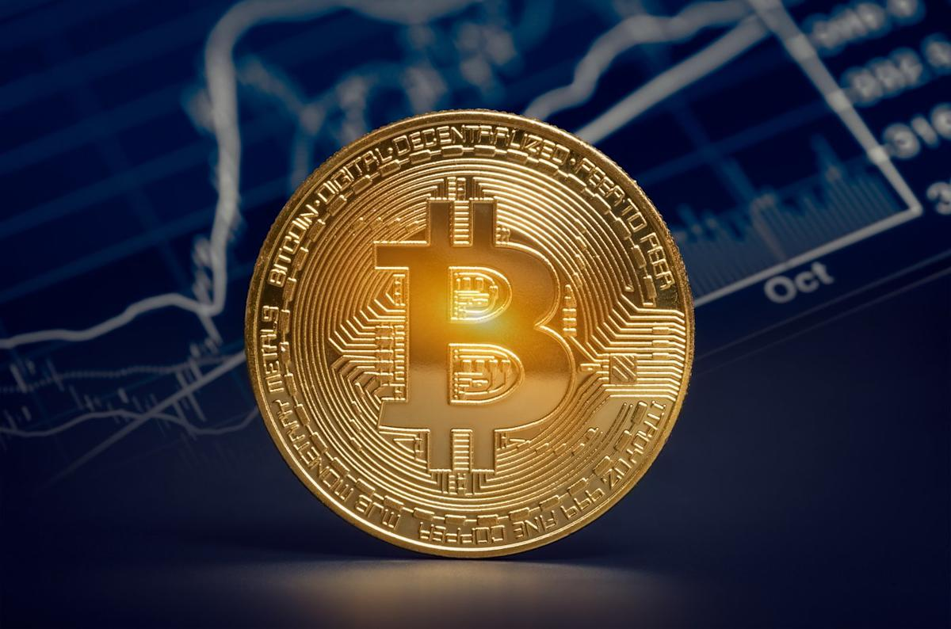
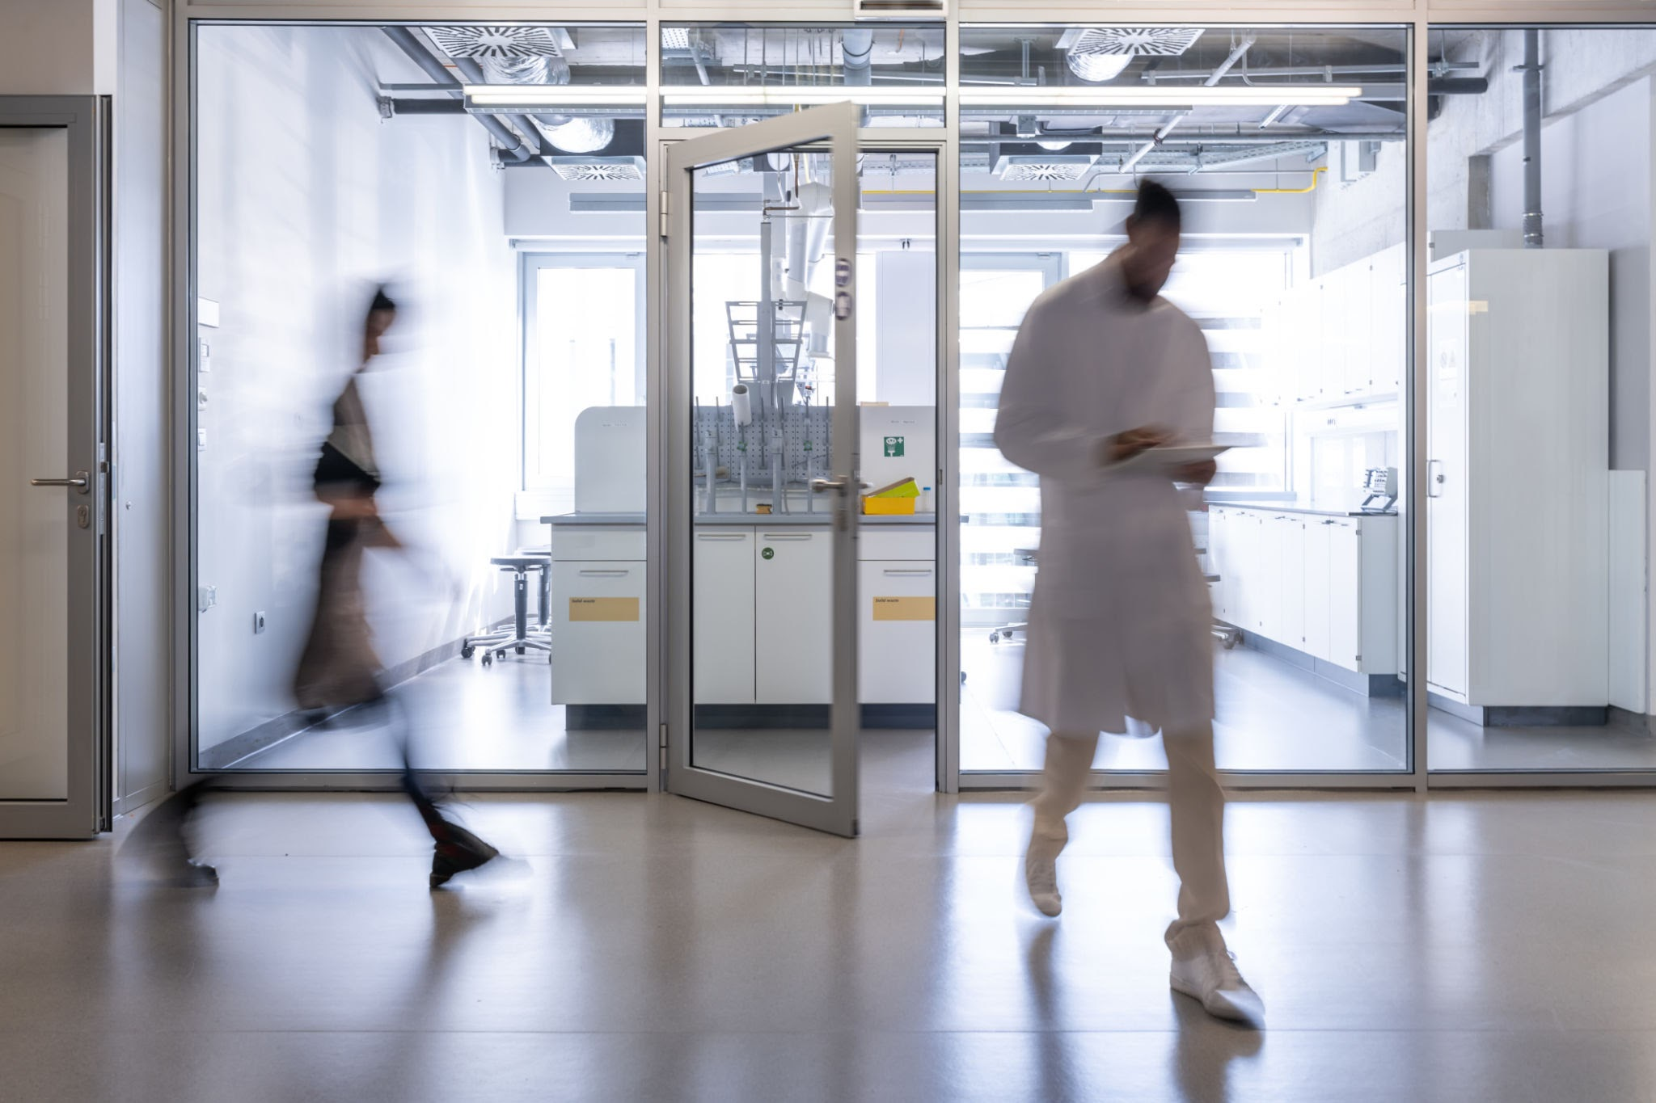
Can Bitcoin be used as an inflation hedge like Gold?
Group 1 : Junyi Zhu, Boping Song, Chenri Luo, Jinlan Wen, Yuntong Zhang
MM.DD.YYYY

Slide 2
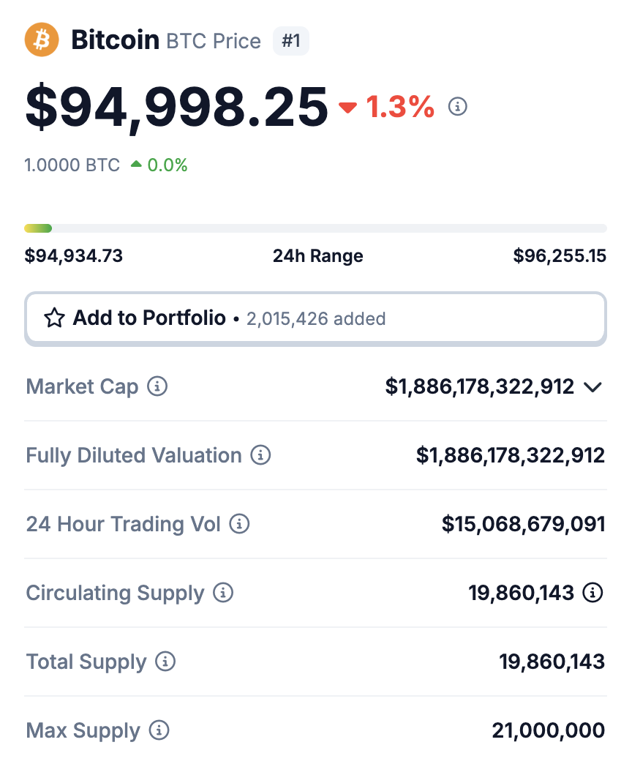
Background: Why Compare Bitcoin and Gold?
In times of rising global inflation, investors seek assets that can preserve value and purchasing power.
Historically, gold has served this purpose — valued for its scarcity, durability, and independence from central banks.
Since the 2008 financial crisis and especially after COVID-19, concerns over fiat currency devaluation have grown.This has led to increased interest in alternative stores of value — notably Bitcoin.
Bitcoin, often labeled “digital gold,” is: Decentralized, Limited in supply (21 million cap), mmune to traditional monetary policy.
https://www.coingecko.com/en/coins/bitcoin

Slide 3
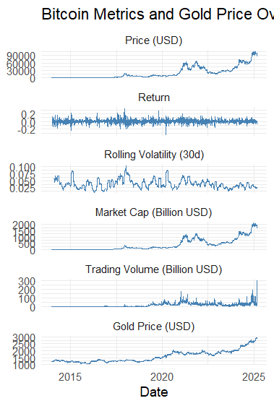
Data Cleaning
Read Bitcoin and Gold data (read.csv())
• Format time columns (lubridate::ymd_hms(), as.Date())
• Align time range from 2013-12-27
• Rename columns (btc_price, btc_market_cap, btc_volume, gold_price)
• Merge data by date (merge())
Derived Variables:
• Daily return: (Price_t - Price_t-1) / Price_t-1
• Rolling volatility: 30-day standard deviation
• Save cleaned dataset (saveRDS(), write.csv())

Slide 4
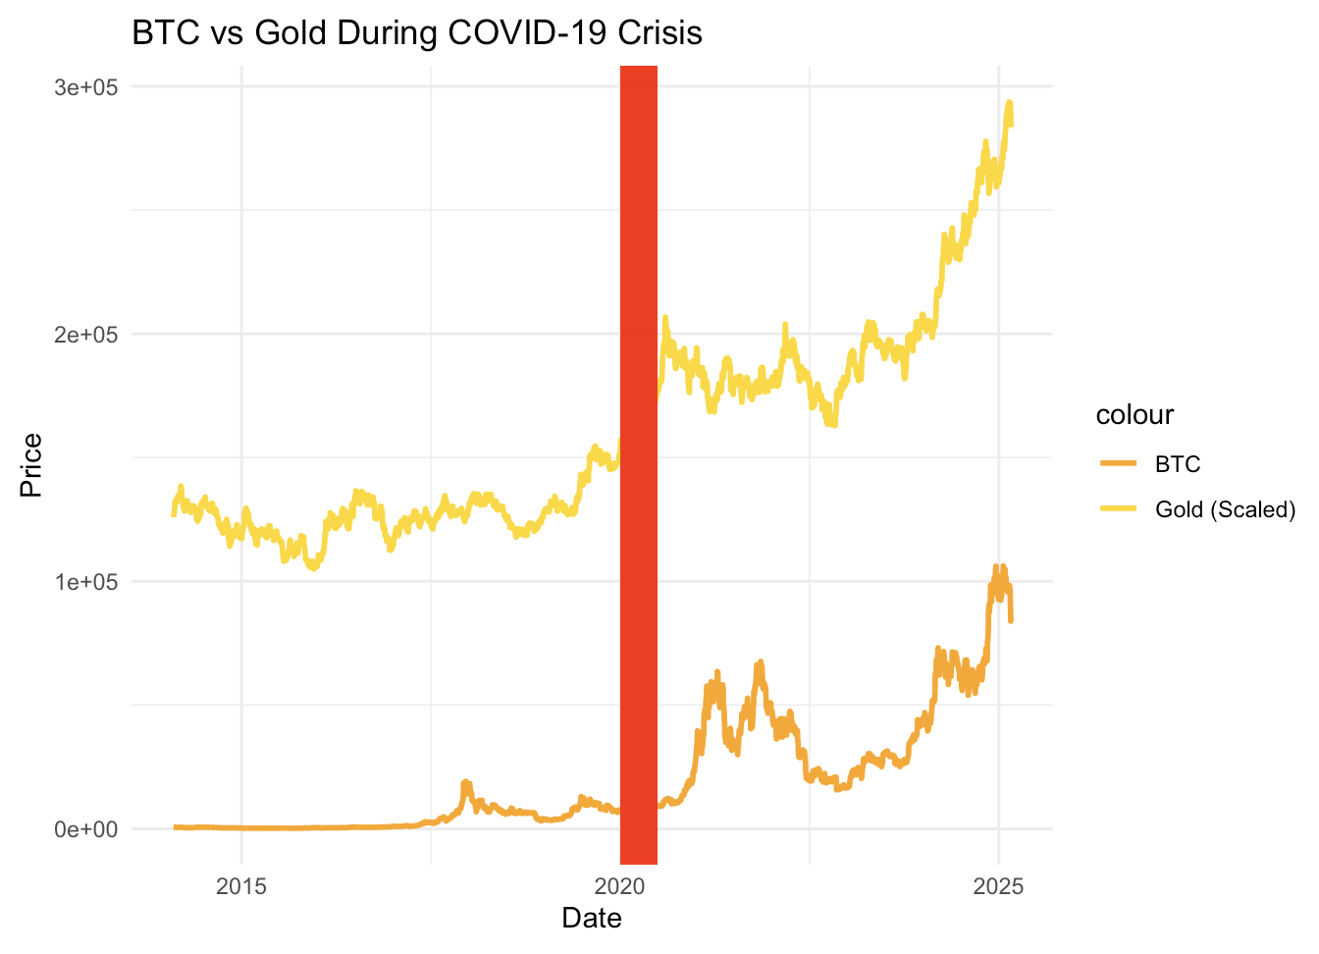
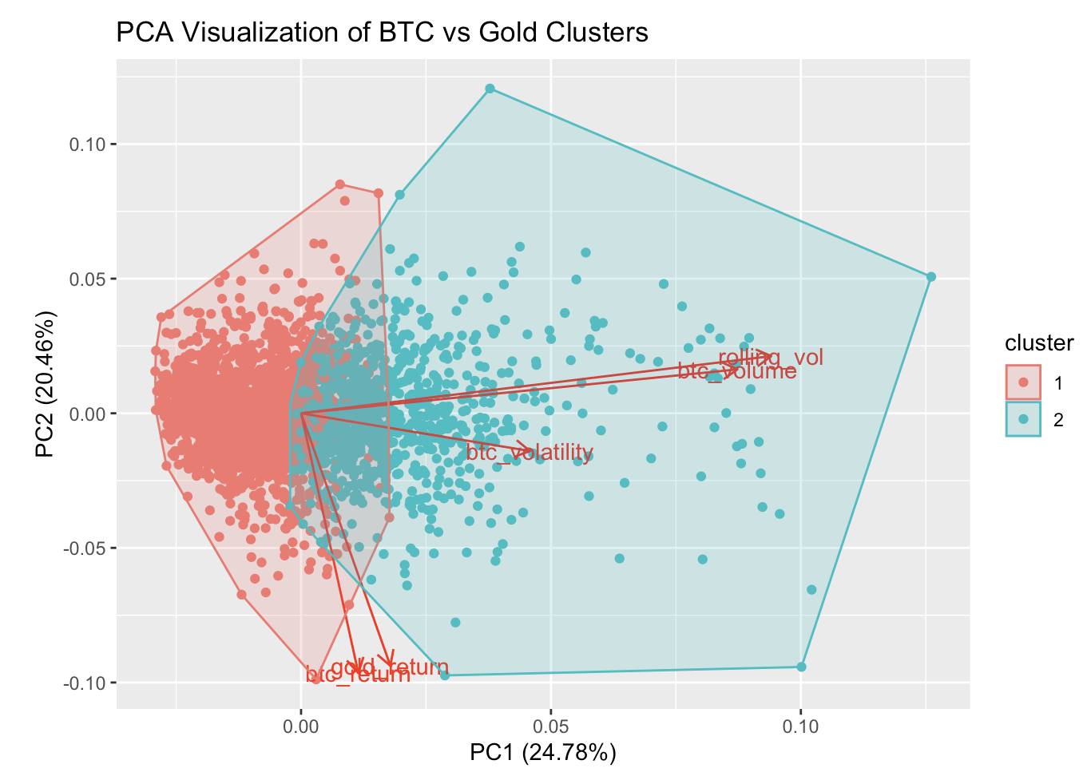
Clustering Analysis: Bitcoin vs. Gold During Crises
Objective
Compare how Bitcoin and Gold behave differently in times of market crisis.
Methods
Crisis vs. Non-Crisis Comparison
Returns: t-test / Mann-Whitney
Volatility: F-test
K-Means Clustering
Features: Return, Volatility, Volume Change
Visualization: PCA for 2D cluster mapping
Key Findings
Gold clusters consistently in low-volatility, safe-haven groups
Bitcoin often clusters as a high-volatility, risk asset in crises
Distinct behaviors suggest divergent safe-haven roles

Slide 5
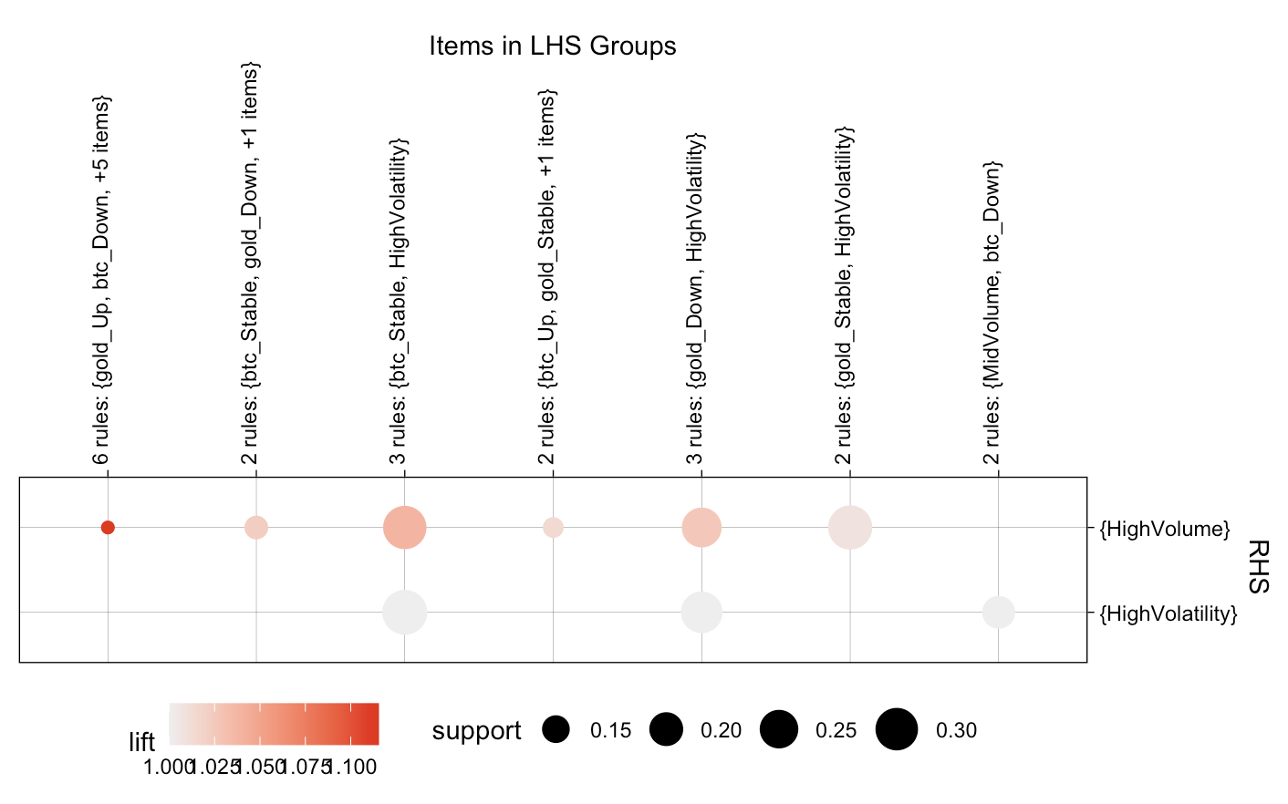
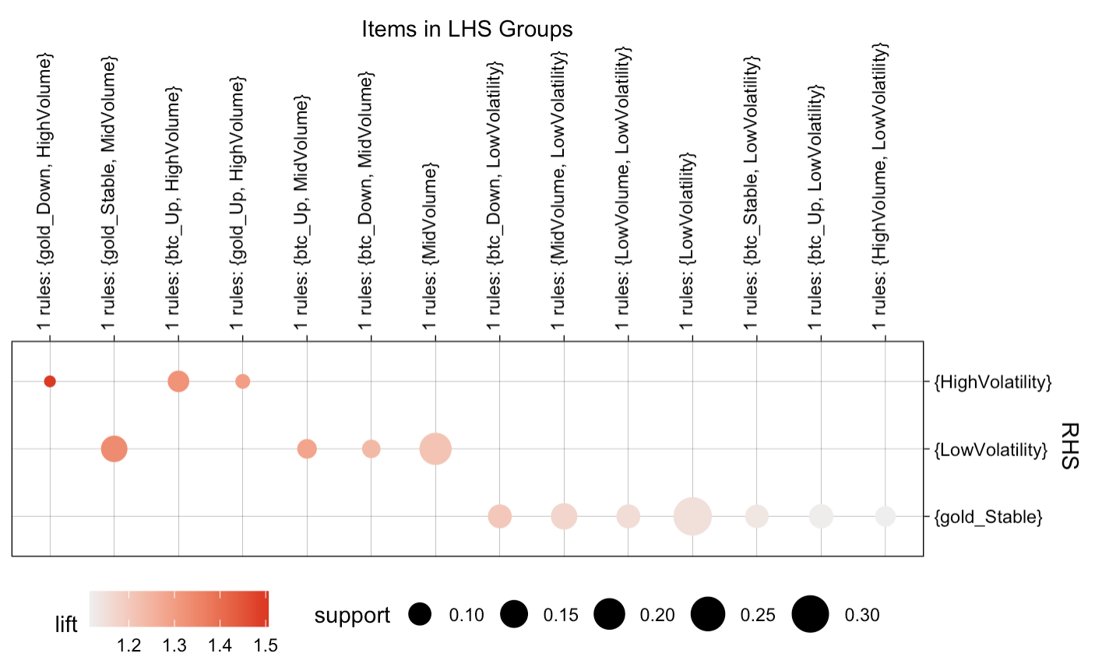
Association Rule Mining
Methods
Data Segmentation：Separated dataset into crisis (e.g., March–June 2020) and non-crisis periods based on market conditions.
Association Rule Mining • Used Apriori algorithm on transactional asset indicators (price trend, volume, volatility). • Evaluated rules using lift, support, and confidence thresholds.
Visualization：Grouped bubble plots and parallel coordinate plots to highlight rule clusters and directional associations.
Crisis Period
Non-Crisis Period

Slide 6
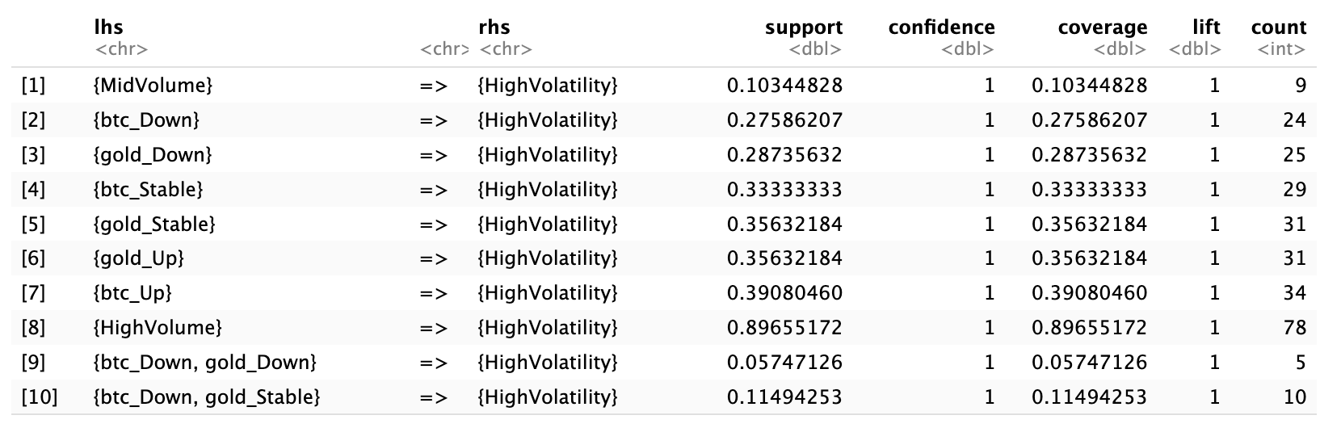
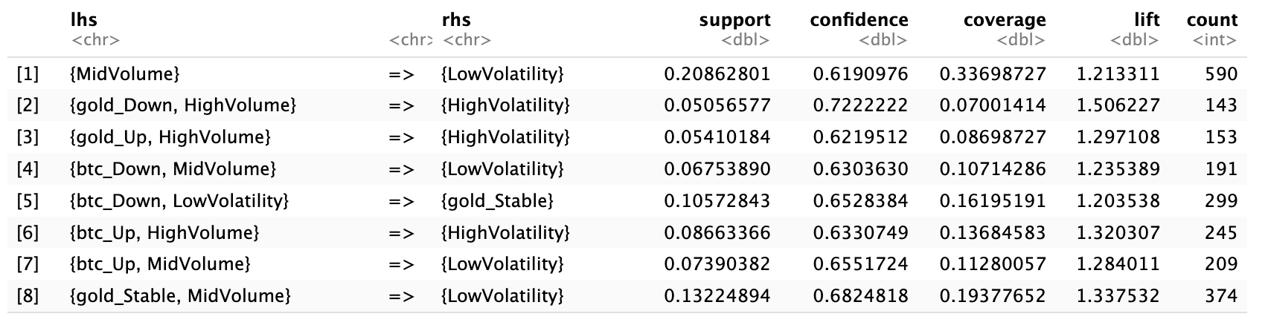
Key Findings
Crisis Period • Most rules pointed to HighVolatility, regardless of asset direction • Confidence = 1.00 but lift ≈ 1.00, indicating weak predictive value • Bitcoin and gold moved with volatility, not against it
Non-Crisis Period • Fewer rules, but stronger patterns (lift > 1.2) • More rules linked to LowVolatility, showing clearer structure • Asset behavior became more interpretable under stable conditions
Conclusion • Bitcoin and gold do not act as hedges during crises • They may serve safe-haven roles only in non-crisis periods, especially with moderate volume
Crisis Period
Non-Crisis Period

Slide 7
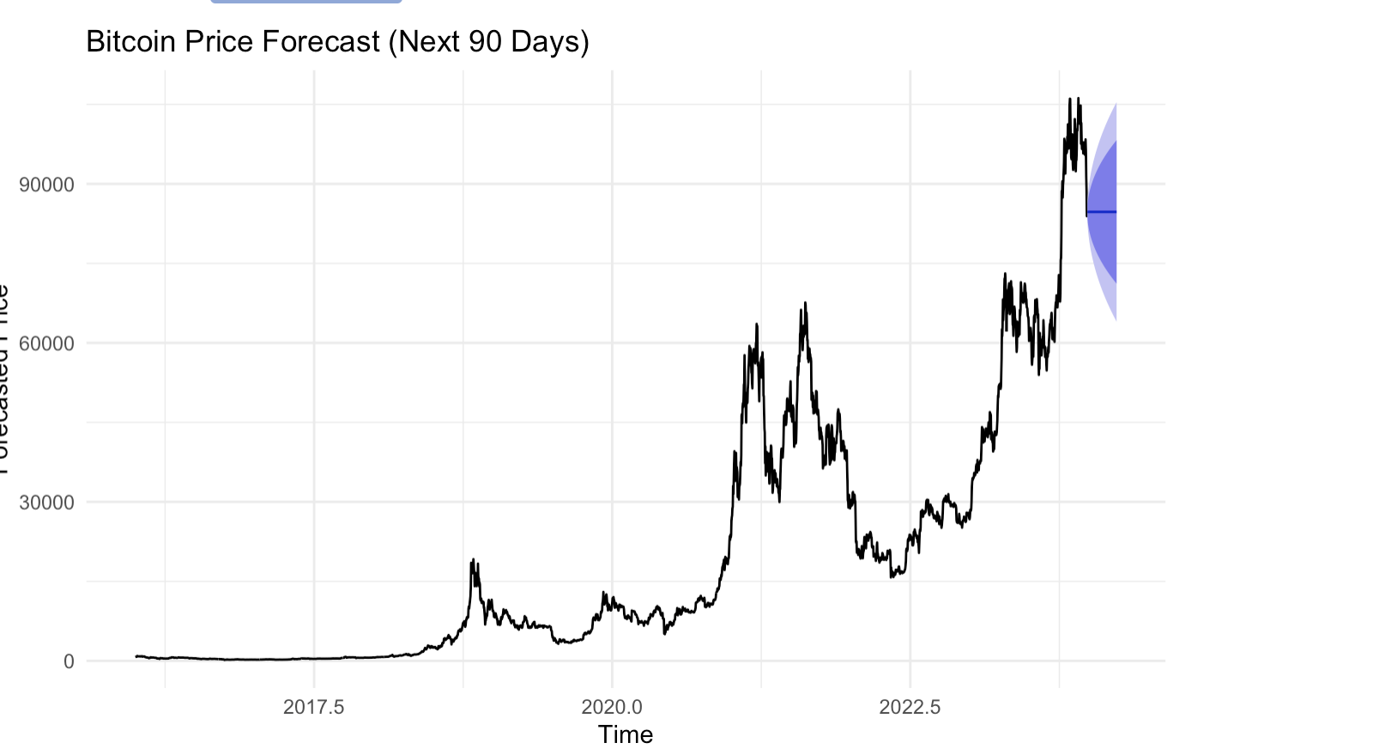
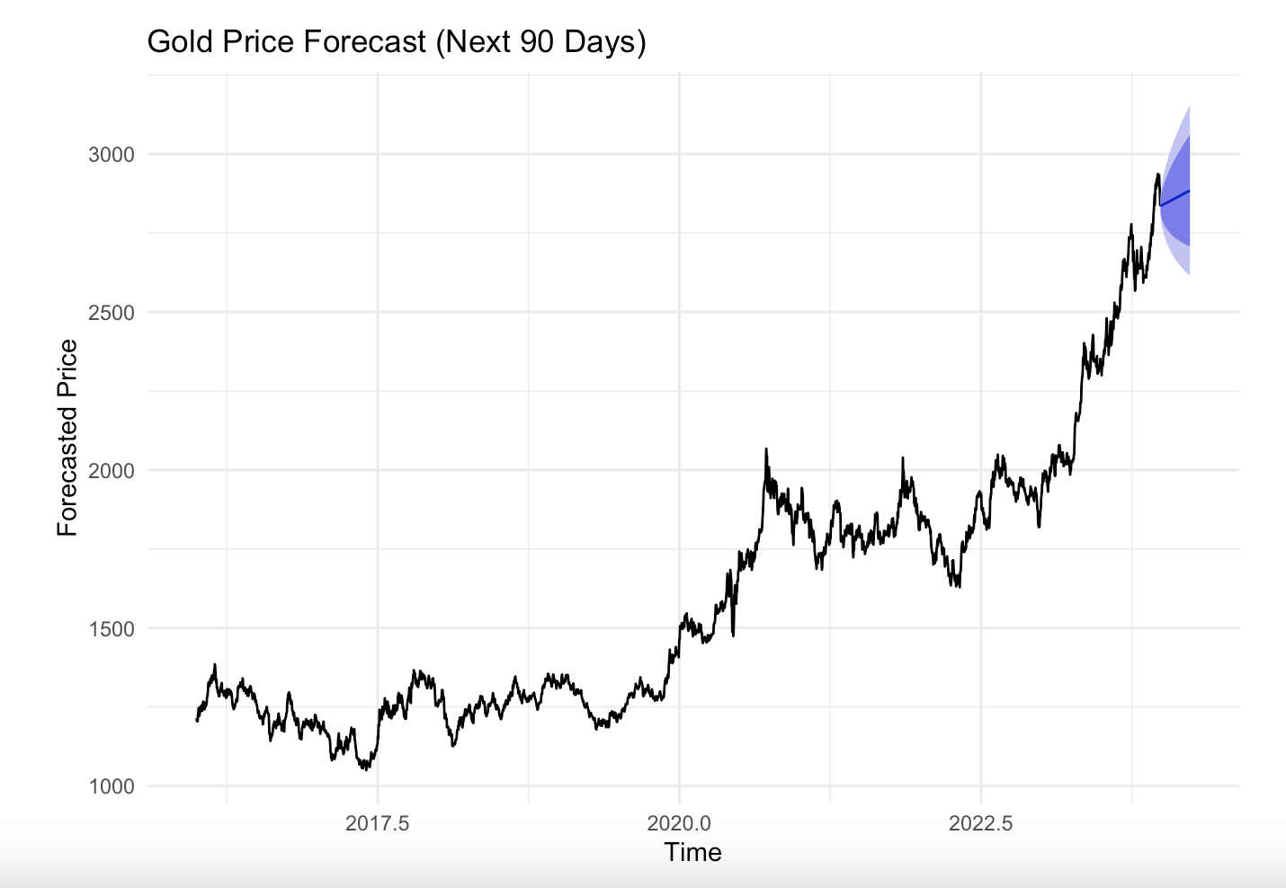
Time Series
Data Preparation
Collected nearly 10 years of daily price data (2016 to 2024)
Converted into time series objects using ts() with frequency set to 365 (daily data).
Stationarity Testing
ADF Test: Tests for unit root (null hypothesis = non-stationary).
KPSS Test: Tests for trend stationarity (null hypothesis = stationary).
Conclusion: Original series are non-stationary → applied log transformation + first differencing.
Model Fitting
Used auto.arima() to select the best-fitting ARIMA model automatically.
Both series fit best with ARIMA(0,1,0); Gold model included a drift term.
Evaluation metrics: AIC, RMSE, MAE, and MAPE.
Forecasting & Visualization
Visualized results using forecast() and autoplot() with confidence intervals.

Slide 8



Conclusion
Key Findings
Recommendation
Bitcoin is high-return, but volatile and speculative during crises.
Gold remains a reliable safe-haven with stable performance and lower risk.
Bitcoin and gold behave fundamentally differently under stress—confirmed by clustering and rule mining.
Use gold as a core inflation hedge.
Treat Bitcoin as a speculative asset, not a substitute for gold.
Consider limited Bitcoin exposure in risk-tolerant portfolios.

Slide 9
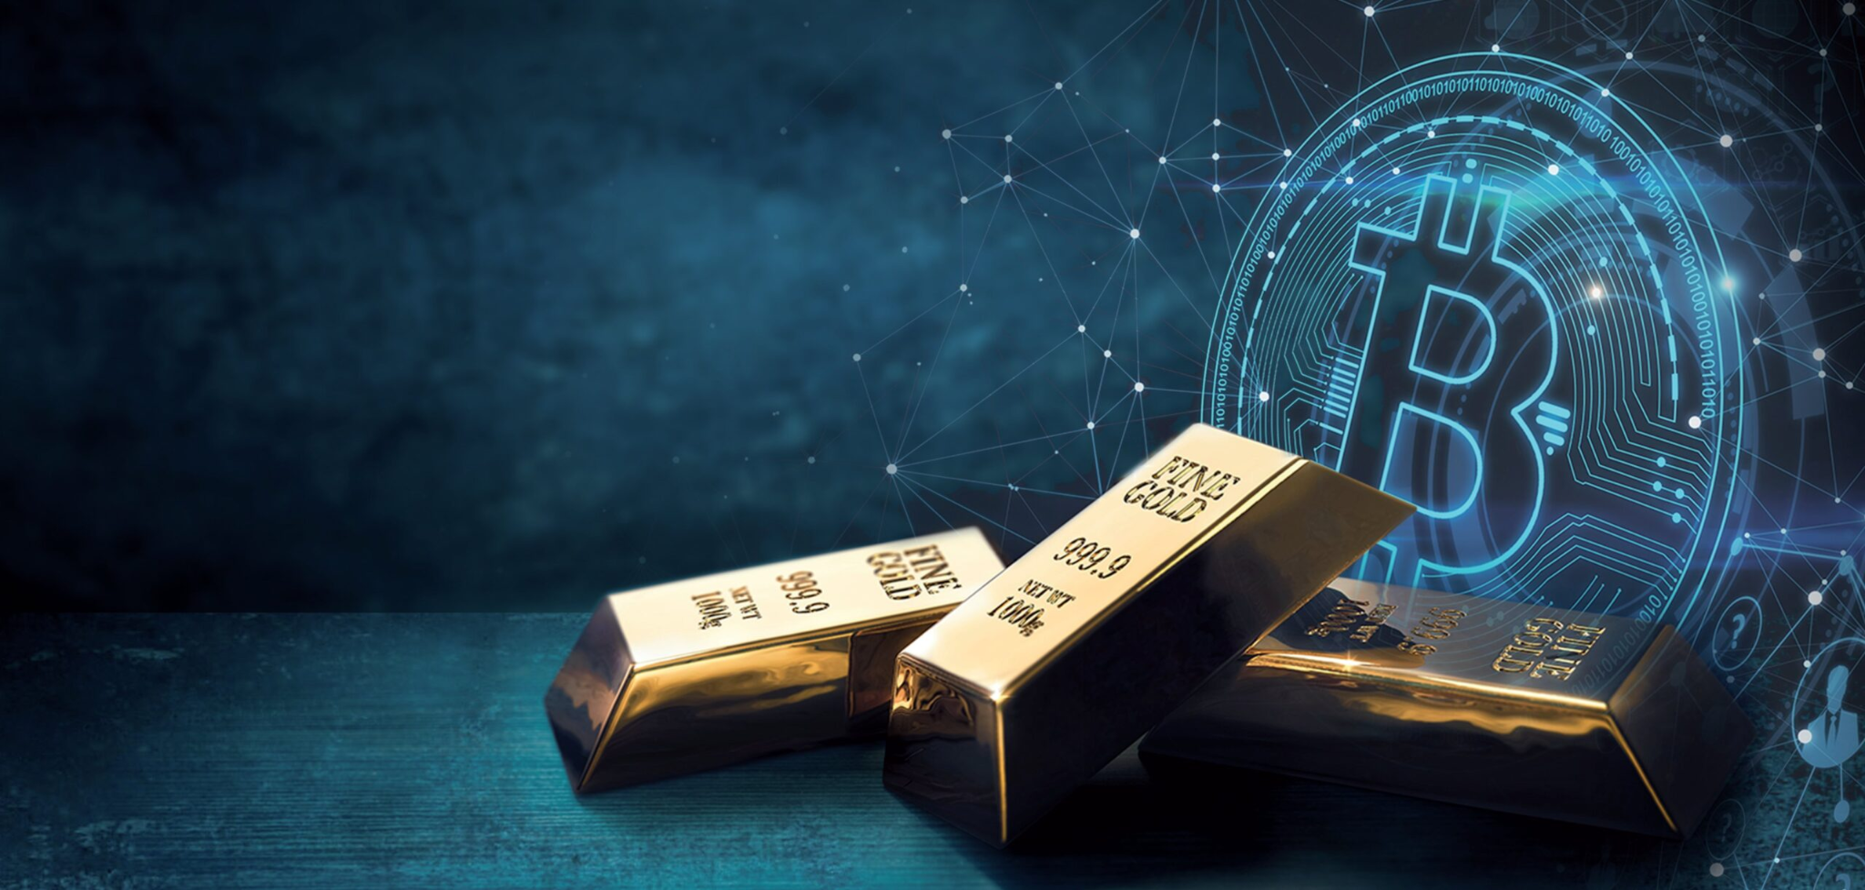
THANK YOU

